Slide 1

Hotel Bar & Minibar Tracking
By
Sahasra Yeruva 2520080062
Bhavika Pawar 2520030616
Team Number: 1
Under the guidance of
D.Pavithra
Assistant Professor
Department of Computer Science and Engineering
Koneru Lakshmaiah Education Foundation (Deemed to be University estd. u/s. 3 of the UGC Act, 1956) Off-Campus: Bachupally-Gandimaisamma Road, Bowrampet, Hyderabad, Telangana - 500 043. Phone No: 7815926816, www.klh.edu.in

Slide 2
Outline of the Presentation
Abstract
Introduction
Problem Statement
Project Flow Diagram
Objectives with Justification
Modules[Frontend web pages]
Expected Outcomes of the Proposed Work
Conclusion
References

Slide 3
Abstract
The SmartSense Hotel Bar & Minibar Management System is a web based hospitality solution designed to automate and optimize minibar inventory management, beverage tracking, billing reconciliation, and room servicing operations.
The system replaces traditional manual tracking methods with a centralized digital platform that provides:
1.Real-time inventory monitoring
2.Automated replenishment workflows
3.Billing synchronization
4.Activity tracking and auditing
5.Low-stock notifications
6.Analytical dashboards
The solution improves operational efficiency, minimizes revenue leakage, reduces billing errors, and enhances guest satisfaction.

Slide 4
Introduction
Hotels often face challenges in managing minibar inventory due to:
1.Manual stock tracking
2.Billing inaccuracies
3.Delayed room servicing
4.Inventory mismatches
5.Lack of centralized monitoring
SmartSense addresses these issues by providing a smart digital platform for tracking minibar consumption, managing inventory, generating reports, and coordinating staff operations in real time.

Slide 5
Problem Statement
Traditional hotel bar and minibar management relies on manual inventory tracking and disconnected communication between departments, leading to stock mismatches, billing errors, revenue leakage, delayed replenishment, and inefficient room servicing; therefore, there is a need for a centralized real time system that automates inventory monitoring, consumption tracking, billing reconciliation, and service coordination.

Slide 6
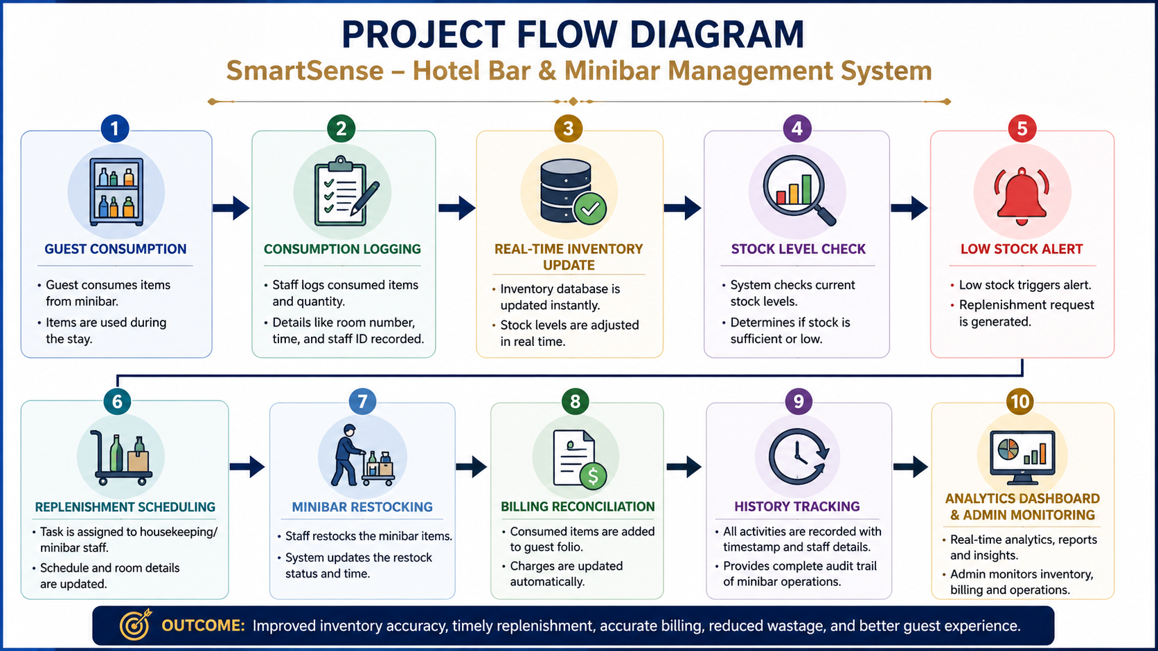

Slide 7
Objectives with Justification
Objective 1:Digitize minibar inventory management.
Justification: Eliminates manual record maintenance.
Objective 2:Provide real-time inventory tracking.
Justification: Prevents stock shortages and delays.
Objective 3:Automate billing reconciliation.
Justification: Improves billing accuracy.
Objective 4:Enable replenishment workflow tracking.
Justification: Enhances staff coordination.
Objective 5:Provide analytics and reporting.
Justification: Supports data driven decision making.

Slide 8
Modules [Frontend web pages]
Home Dashboard
Minibar Log
Consumption Form
Replenishment Schedule
Notifications
Inventory Charts
History Tracking

Slide 9
Expected Outcomes of the Proposed Work
Improved minibar inventory accuracy
Real-time stock monitoring
Faster replenishment process
Reduced inventory wastage
Improved billing accuracy
Better staff accountability
Automated report generation
Enhanced guest satisfaction
Centralized hotel minibar management

Slide 10
Conclusion and Future Scope
SmartSense provides a centralized platform for managing hotel minibar operations through automation, inventory tracking, billing integration, and analytics Future Scope:
AI-based demand forecasting
IoT-enabled smart minibar sensors
Mobile application integration
Cloud deployment
Predictive inventory analytics
Multi-property hotel management support

Slide 11
References
Weerasinghe, W.P.S.W., et al., "Research on Hotel Management System",
Sri Lanka Institute of Information Technology, 2022.
Hotel Inventory Management System, International Journal of Advanced
Research in Computer and Communication Engineering (IJARCCE).
What an Important Room Mini Bar Management in Hotel PMS,
MyHotelLine Blog – Inventory control, real-time monitoring, automated billing,
and minibar analytics.
Hotel Inventory Management Software: A Complete Guide, SiteMinder –
Hotel inventory tracking, revenue optimization, reporting, and operational efficiency.
Hotel Booking Web Application using MERN Stack, International Journal
of Innovative Research in Science, Engineering and Technology (IJIRSET), 2025

Slide 12
Thank you

